Slide 1
DPM Final Project – Week 4
TEAM 11

Slide 2
Gantt Chart Update
Refer to Application

Slide 3
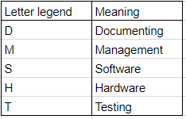
Budget Update

Slide 4
Design Changes
Had difficulty crossing the bridge
Needed fix wheel
Addedd landing gear wheel

Slide 5
Testing Design Update
Tested US sensor
Tested track of updated robot
Tested its ability to put down the extra wheel
Tested ability to cross bridge

Slide 6
Testing Design Upcoming
Deterimine what tests are appropriate to be done before beta demo

Slide 7
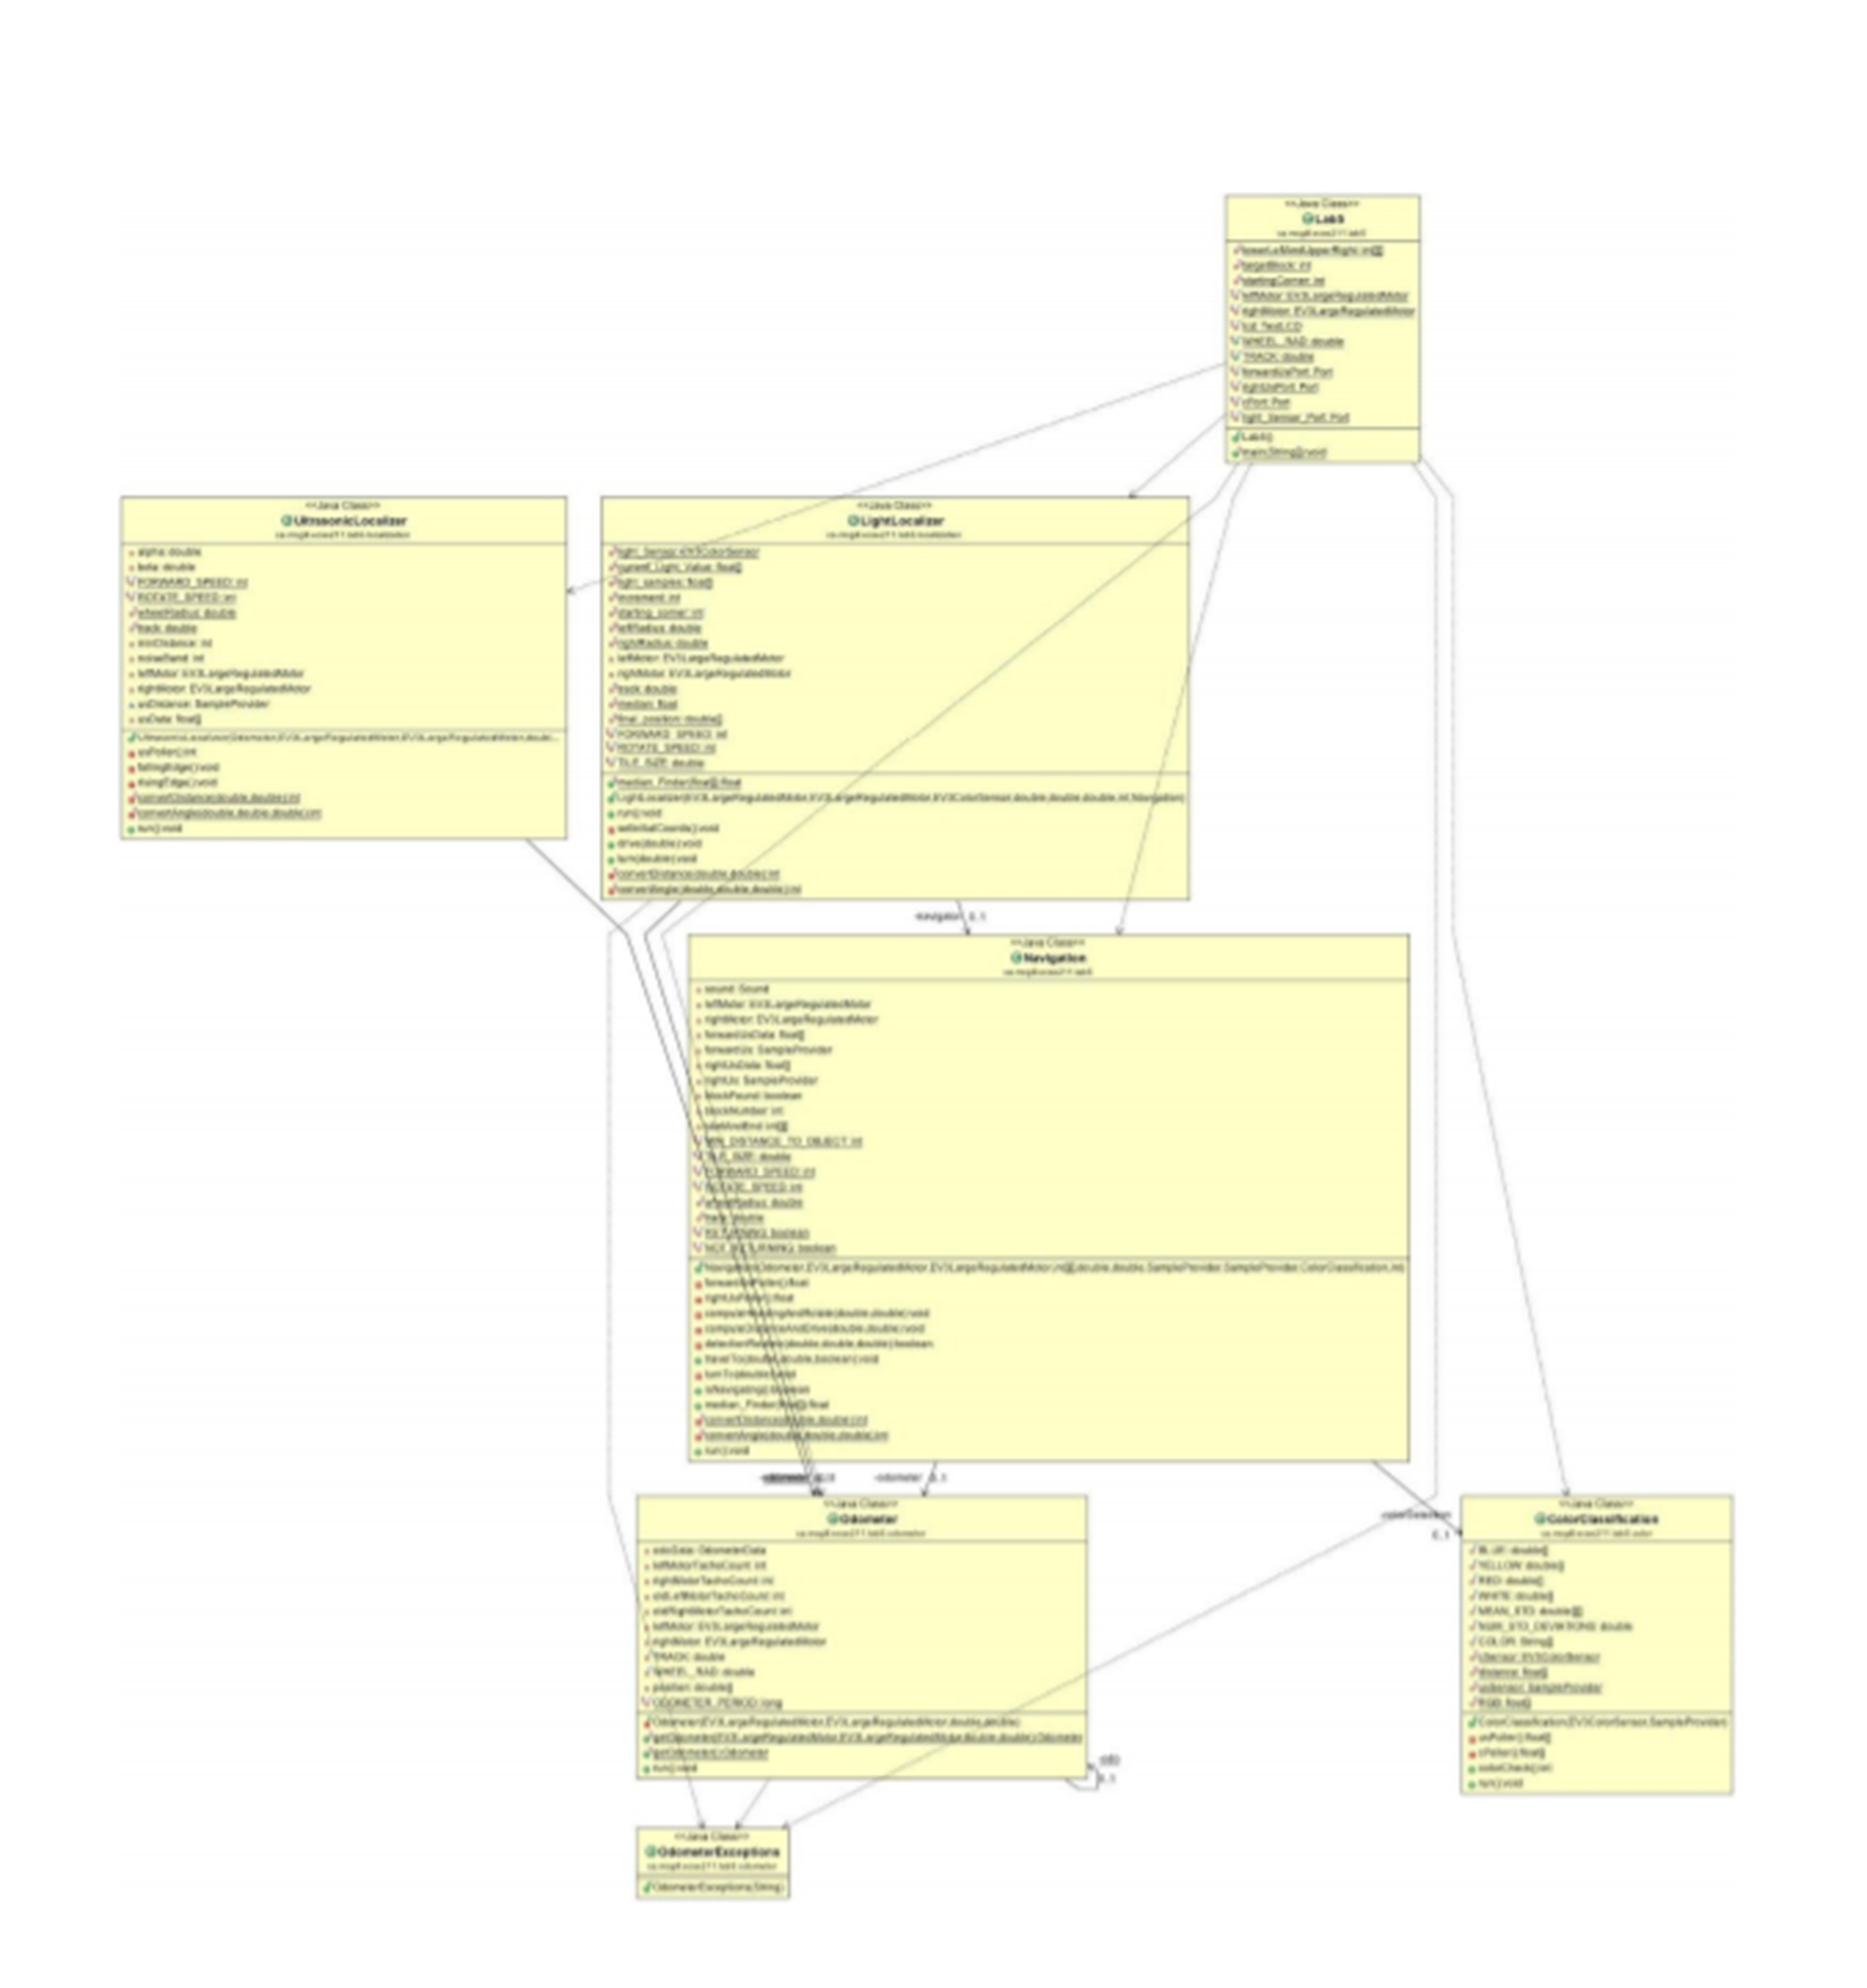
Software Class Hierarchy
Major Changes to be made:
Lab5.class -> Controller.class (contains the obstacle avoidance code and main function)
ColourCalibration.class: removal of multi-block system (only one flag)
Navigation.class: Change from radians to degree
Navigation.class: addition of simple movement classes
Display.class -> Removed (useless thread)
LightLocalizer : Code change to different localization system
Robot.class : New robot class to contain all variables to limit RAM usage due to public variables/duplicates
Old Class Hierarchy

Slide 8
API Documentation
JAVA Docs
To be further worked on after changes

Slide 9
Status of Code
Behind on software
Implemented:
Robot Class, Odometry, Controller, Navigation
To Do:
Continue Localization, Search & Localize, Avoidance

Slide 10
Next Steps
Push on software to catch-up
Testing software components as they are completed
Full end-to-end testing for demo
Update documentation based on improvements and tests

Slide 11
Any Questions?

